Slide 1



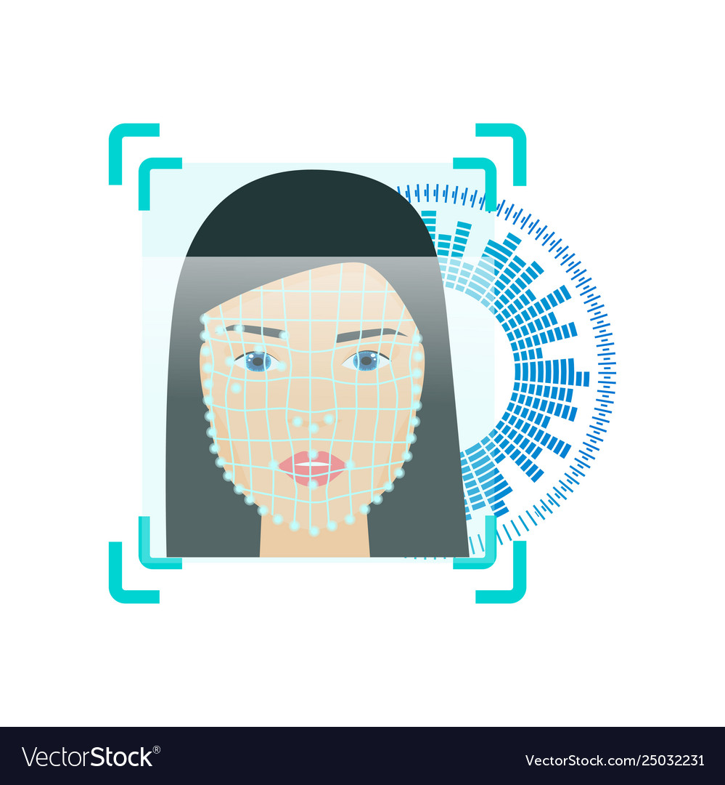
Real Time Based Facial Recognition System
Organization: Bureau of Police Research & Development
Problem Statement No. : RK 308
STUDENTS:
S.Surya Mohan
R.Amrita
K.Harish
G.Greeshma
P.Ram Mohana
R.N.priyatham
MENTORS:
Dr. Pallavi Khare
B. Indira Priyadarshini

Slide 2

problem at hand Hand
What if a person commit crime for the first time?
There would be no information of the criminal in the police department’s database.
How to solve this problem?

Slide 3

Proposed Solution Solution
Now a days, almost everyone is using the social media.
Our project is to emphasize that, we can try extracting the information of the criminal from the social media.

Slide 4
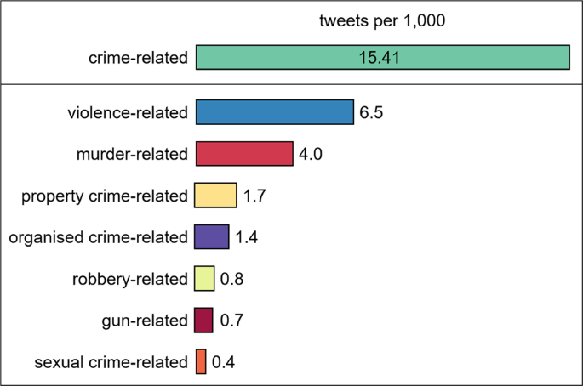
Our Project deals with extracting information from Twitter. The image beside, are the statistics from internet.

Slide 5

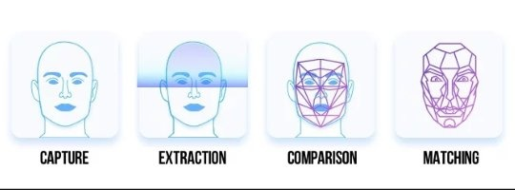
Our Project Implementation

Slide 6
FLOW CHART
Start
Browse image of criminal in app and upload to server/computer
Fetch image of criminal in server/computer
Download the Images and data from social media
Perform Facial recognition of criminal image with social media images in server/computer
If match found
Write corresponding data in to the database
From mobile app fetch the results from database and display
Stop

Slide 7
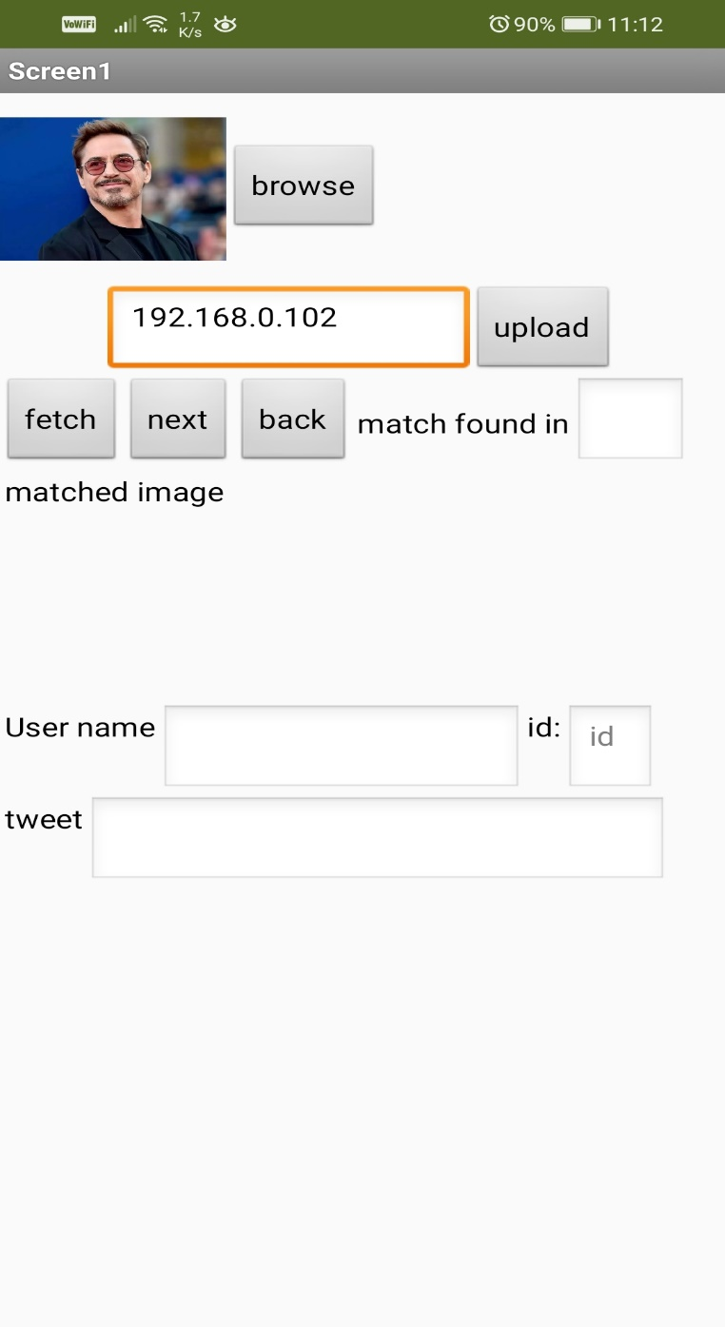

Slide 8
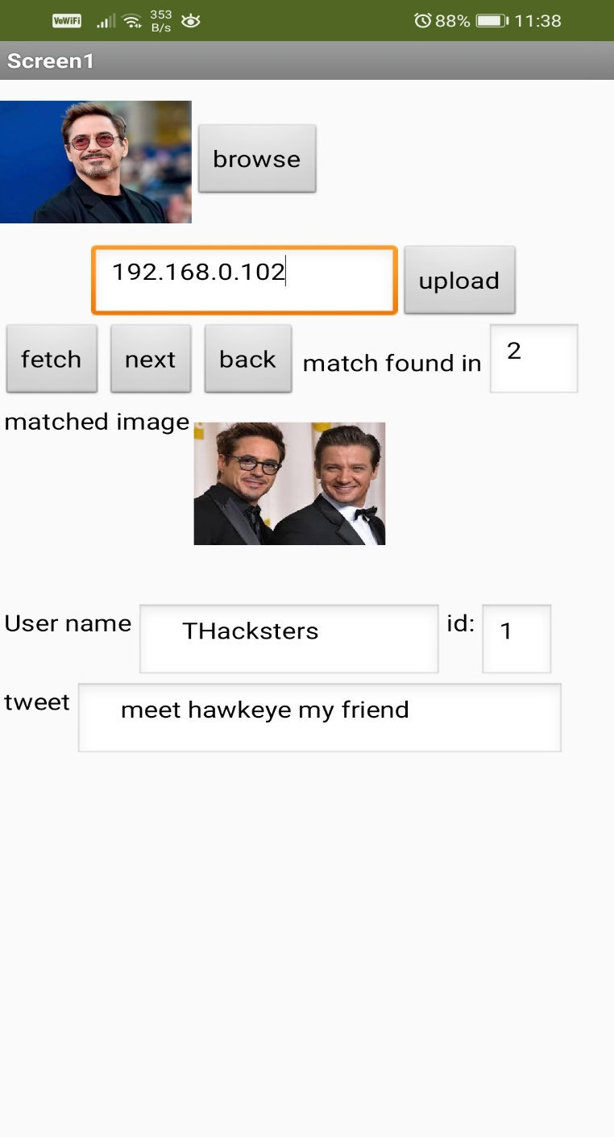
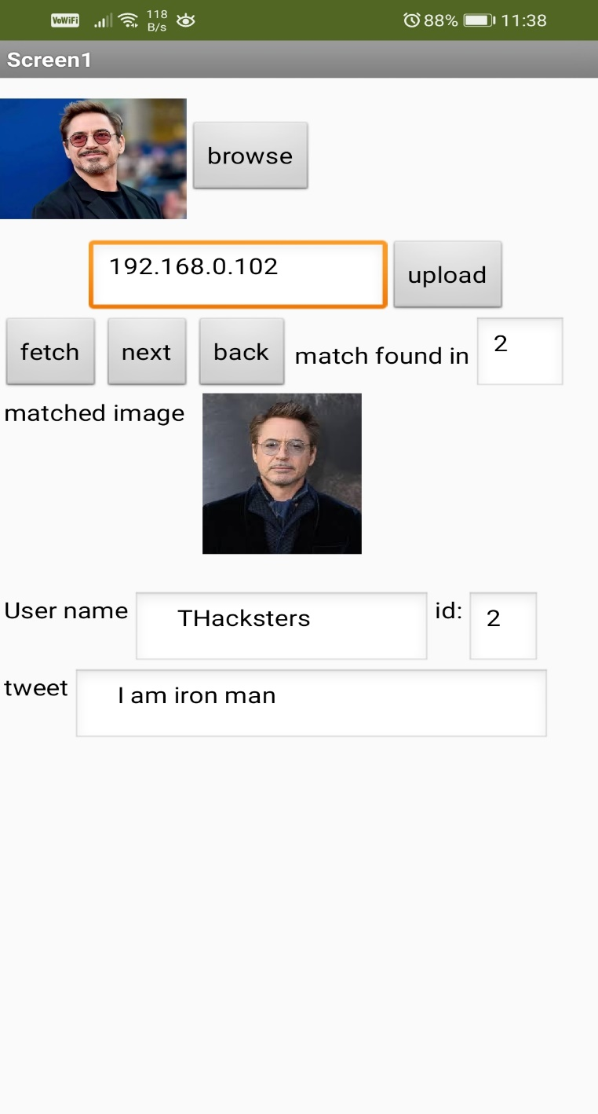

Slide 9

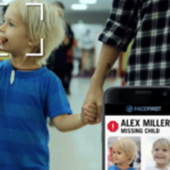
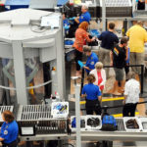
Application
UNLOCK PHONES : This technology is a powerful way to protect personal data and ensure that, if a phone is stolen, sensitive data remains inaccessible by
the perpetrator
FIND MISSING PERSONS : Face recognition can be used to find missing children and victims of human trafficking. As long as missing individuals are added to a database, law enforcement can become alerted as soon as they are recognized by face recognition—be it an airport, retail store or other public space
MAKE AIR TRAVEL MORE CONVENIENT : Face recognition to help people check bags, check into flights and board planes faster.

Slide 10

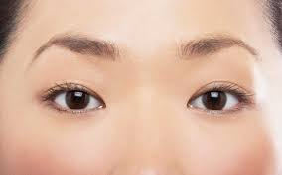
Future Scope Theoretical Approach
In order to deal with problem in identifying the criminals with mask…
Extract the portion of the face that is not covered by the mask and then perform the comparison for better accuracy.

Slide 11


